Slide 1
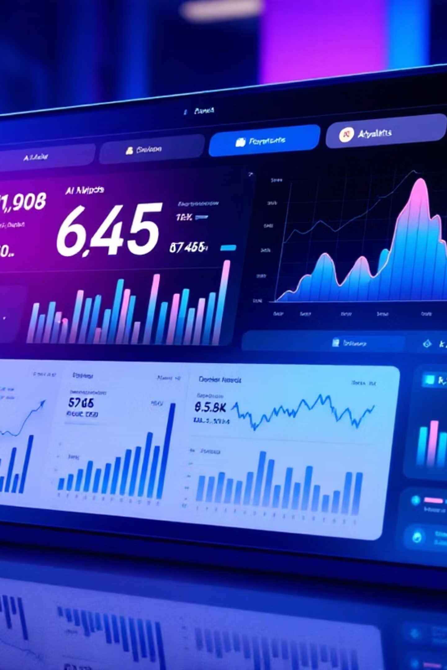
Intelligent Stock Forecasting Platform
A machine learning-powered web application that democratizes stock prediction for private investors through advanced algorithms and intuitive design.

Slide 2

The Challenge: Information Asymmetry in Markets
Limited Access
Data Overwhelm
Model Complexity
Professional-grade forecasting tools are expensive and complex, excluding retail investors from sophisticated analysis.
Raw financial data requires expertise to interpret, leaving investors relying on outdated methods or gut instinct.
Machine learning models for finance are technically challenging to implement and validate for individual use.

Slide 3
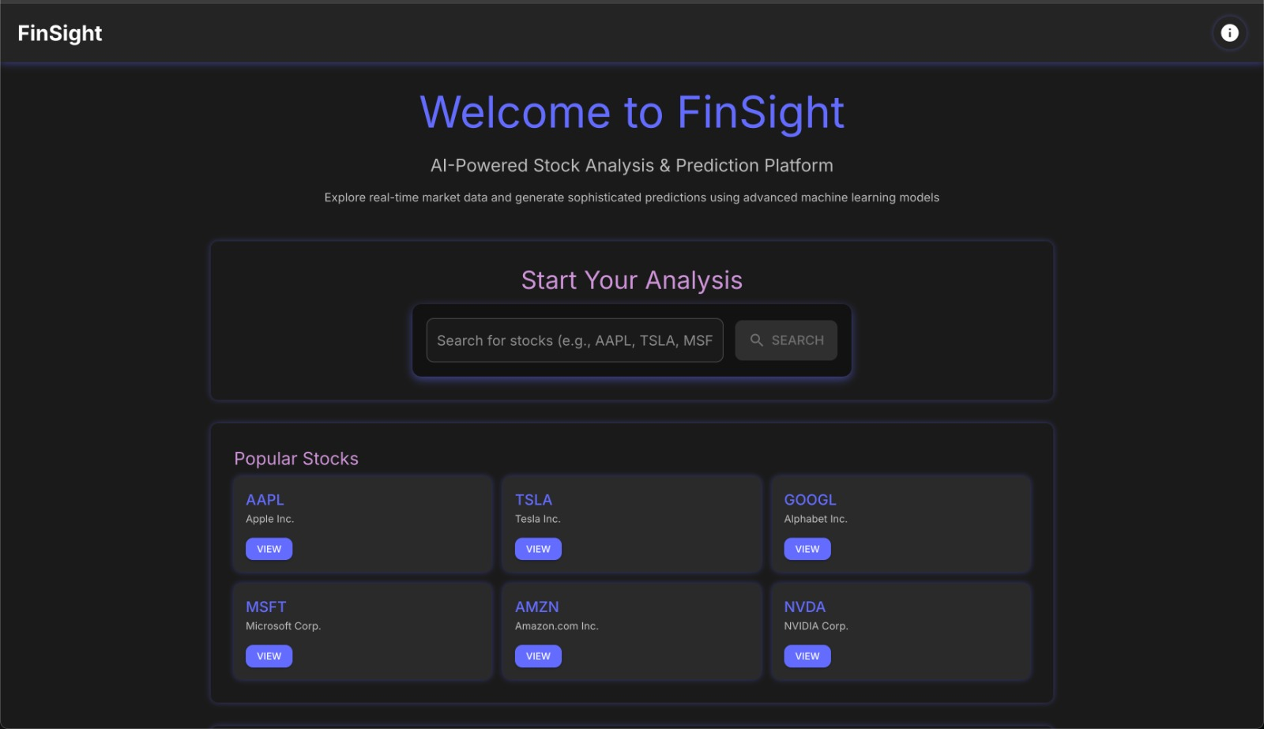
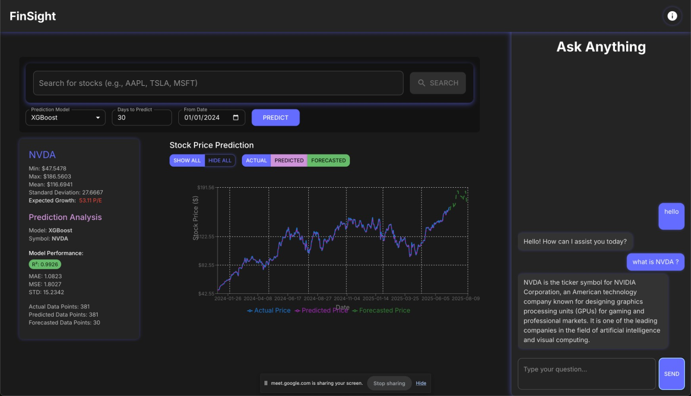
Solution: AI-Powered Stock Prediction Platform
Core Functionality
Select any stock symbol for analysis
View comprehensive historical data visualization
Run three distinct ML models simultaneously
Compare prediction results with interactive charts
AI chatbot for market insights and explanations

Slide 4



Modern UI/UX Design Philosophy
Responsive React Interface
Data-Driven Visualization
User-Centric Experience
Clean, modern design that adapts seamlessly across devices with intuitive navigation and fast loading times.
Clear presentation of complex financial data through interactive charts and comparative model outputs.
Designed for both technical and non-technical users with progressive disclosure and contextual help.

Slide 5



Technology Stack & Architecture
React Frontend
Flask Backend
ML Models
Dynamic UI with component-based architecture for scalability and maintainability.
Lightweight API serving ML models with efficient data processing and Yahoo Finance integration.
XGBoost for gradient boosting, GRU for sequential patterns, LightGBM for high-performance predictions.

Slide 6
Future Roadmap & Expansion
Multi-Stock Portfolio
Personalization
Enable simultaneous analysis of multiple securities with correlation insights and risk assessment.
User behavior-based customization, saved preferences, and tailored investment recommendations.
1
2
3
Advanced Analytics
Technical indicators integration, sentiment analysis, and Prophet/ARIMA model additions for comprehensive forecasting.

